Slide 1
WELCOME TO OUR PRESENTATION
ID
20191130010 20181065010 20191132010 20201168010 20191133010 20171110010 20191135010 20171096010

Slide 2
TOPIC
What do you mean by odd and even?
Discuss about an even function and odd function of a
Fourier series.
Find the Fourier series expansion of the periodic function of period 2𝜋, 𝑓(𝑥) = 𝑥² ; −𝜋 < 𝑥 < 𝜋. Hence, find the sum of the series,
1/1² - 1/2² + 1/3² - 1/4² +…………….

Slide 3
ODD NUMBER
Odd numbers are whole numbers that cannot be divided exactly into pairs.
Odd numbers, when divided by 2, leave a remainder of 1.
1, 3, 5, 7, 9, 11, 13, 15 … are sequential odd numbers.
Odd numbers have the digits 1, 3, 5, 7 or 9 in their ones place.

Slide 4
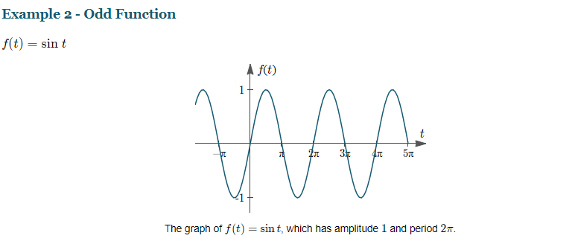
GRAPH FOR ODD FUNCTION

Slide 5
EVEN NUMBER
Any integer (never a fraction) that can be divided exactly by 2.
The last digit is 0, 2, 4, 6 or 8
Example: -24, 0, 6 and 38 are all even numbers

Slide 6
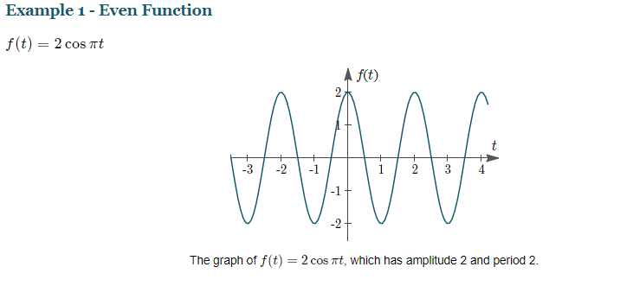
GRAPH FOR EVEN FUNCTION

Slide 7
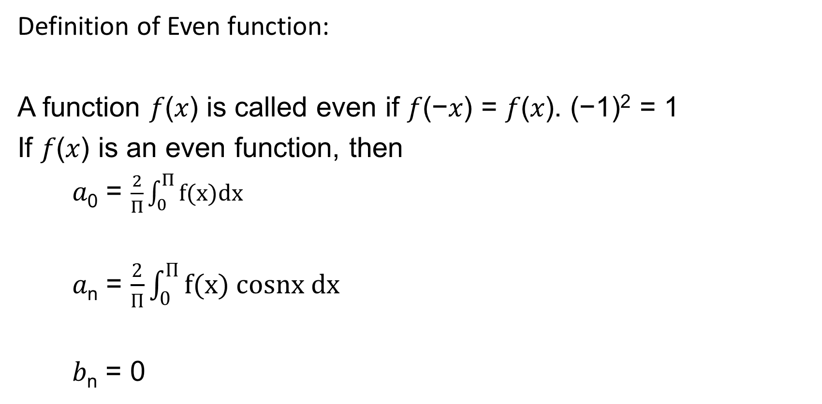
Fourier series for EVEN FUNCTION
Definition of Even function:
A function 𝑓(𝑥) is called even if 𝑓(−𝑥) = 𝑓(𝑥). (−1)² = 1
If 𝑓(𝑥) is an even function, then
𝑎₀ = $\frac{2}{Π}\int_{0}^{Π}{f(x)dx}$
𝑎_{n} = $\frac{2}{Π}\int_{0}^{Π}{f(x) cosnx dx }$
𝑏_{n} = 0

Slide 8
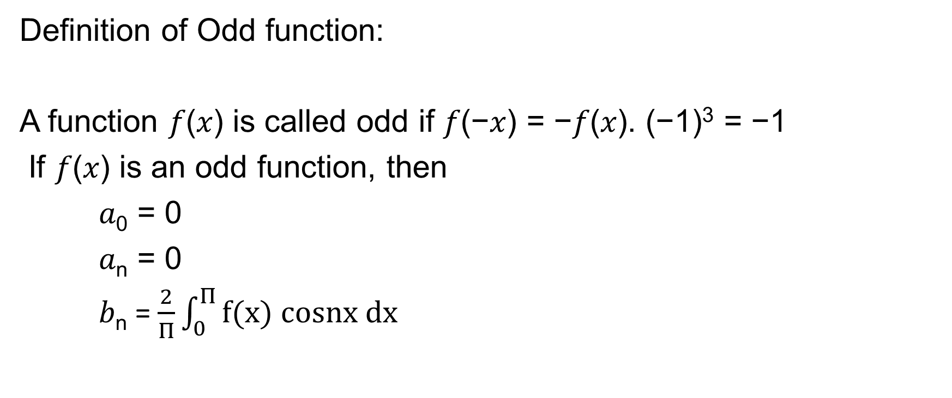
Fourier series for ODD FUNCTION
Definition of Odd function:
A function 𝑓(𝑥) is called odd if 𝑓(−𝑥) = −𝑓(𝑥). (−1)³ = −1
If 𝑓(𝑥) is an odd function, then
𝑎₀ = 0
𝑎_{n} = 0
𝑏_{n} = $\frac{2}{Π}\int_{0}^{Π}{f(x) cosnx dx }$

Slide 9
QUESTION
Find the Fourier series expansion of the periodic function of period 2𝜋, 𝑓(𝑥) = 𝑥² ; −𝜋 < 𝑥 < 𝜋. Hence, find the sum of the series,
1/1² - 1/2² + 1/3² - 1/4² +…………….

Slide 10
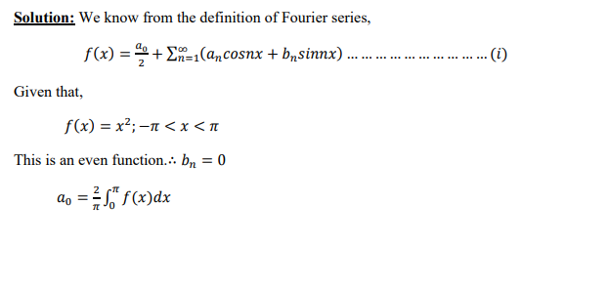
Solution

Slide 11
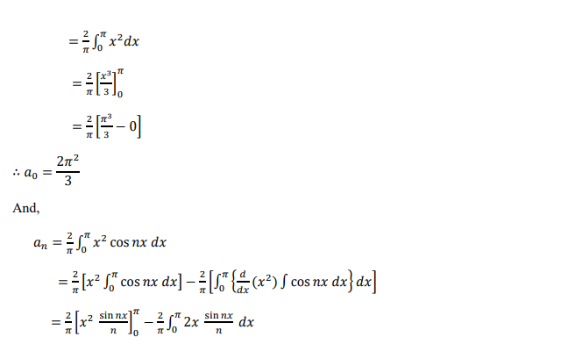
Solution

Slide 12
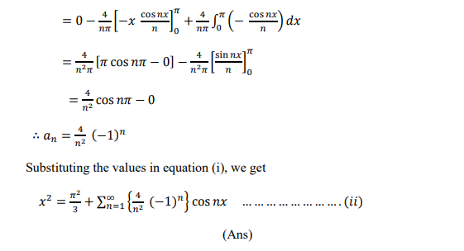
Solution

Slide 13
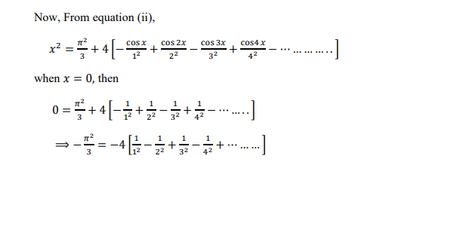
Solution

Slide 14
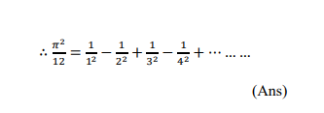
SOLUTION

Slide 15
THE END
THANK YOU

